Slide 1
The XSS Issue
Rowan Puckeridge

Slide 2
The Problem
If relatively simple attacks such as XSS and CSRF are still in the OWASP Top 10, why do they still pose such a threat to businesses?

Slide 3
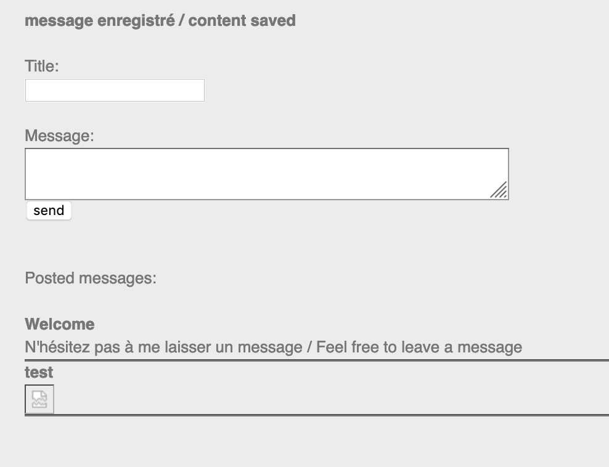
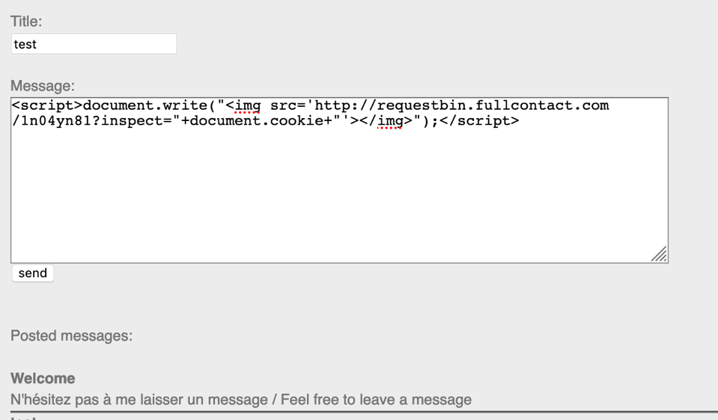
Stored XSS - Example

Slide 4
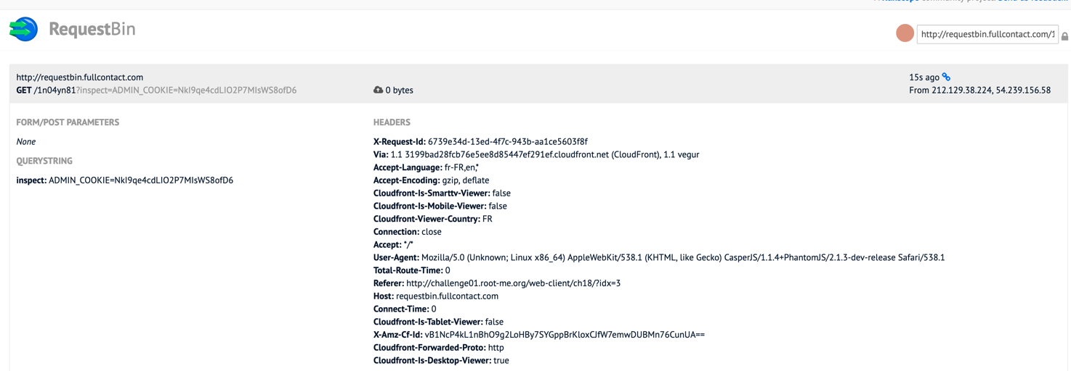
Stored XSS - Example

Slide 5
The Impact
Central bank of Bangladesh lost $100 million
Attackers used simple and well known attacks to gain authorization
Vulnerabilities were dismissed by developers and government
Steam Web Chat
Did not sanitise BBCode (used in forums)
Attackers can inject malicious links

Slide 6
Mitigation
Escaping
Taking data an app has received and ensuring it’s secure before rendering it for the end user
E.g. - < > - &
Validating Input
Expect any untrusted/outside data to be malicious
Prevent harm to database, site and users
Sanitizing
Scrubs data clean of potentially harmful markup
All three are necessary!

Slide 7
The SDLC Issue
Lack of quality software testing
SDLC trends - software is simply pushed with little testing and patched for bugs after launch
Bug bounties are good for both businesses and hackers
Can make companies complacent about testing and security

